Slide 1
High-throughput Data Analysis
with a focus on RNA-seq
Ricardo Gonzalo and Mireia Ferrer
ricardo.gonzalo@vhir.org / mireia.ferrer@vhir.org
2020/ 02 / 19

Slide 2
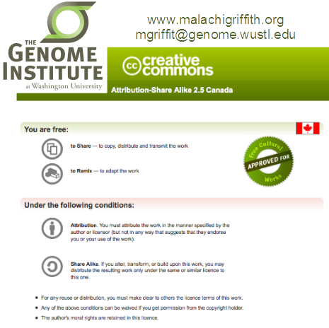

DISCLAIMER
This lecture is based on many presentation freely available on the web.
We wish to acknowledge the authors for their efforts and for making their work available.
In particular, we adapted several contents from the Canadian Bioinformatics RNA-seq workshop.
Notes:
2

Slide 3
TABLE OF CONTENTS
Introduction to Next Generation Sequencing (NGS) technology
Applications of NGS
Bioinformatics challenges of NGS
Steps in NGS data analysis
Introduction to RNA-seq and Expression analysis
Introduction to Galaxy
RNA-seq analysis exercise with Galaxy
Exercise overview and Input data
Quality Control and pre-processing of raw data
Reads mapping
Summarization to get raw counts
Differential expression analysis (plots, normalization and testing)
Notes:
3

Slide 4
TABLE OF CONTENTS
Introduction to Next Generation Sequencing (NGS) technology
Applications of NGS
Bioinformatics challenges of NGS
Steps in NGS data analysis
Introduction to RNA-seq and Expression analysis
Introduction to Galaxy
RNA-seq analysis exercise with Galaxy
Exercise overview and Input data
Quality Control and pre-processing of raw data
Reads mapping
Summarization to get raw counts
Differential expression analysis (plots, normalization and testing)
Notes:
4

Slide 5
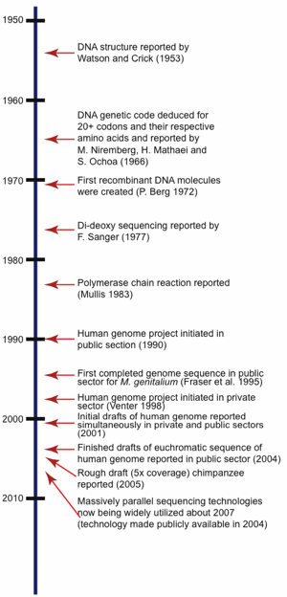
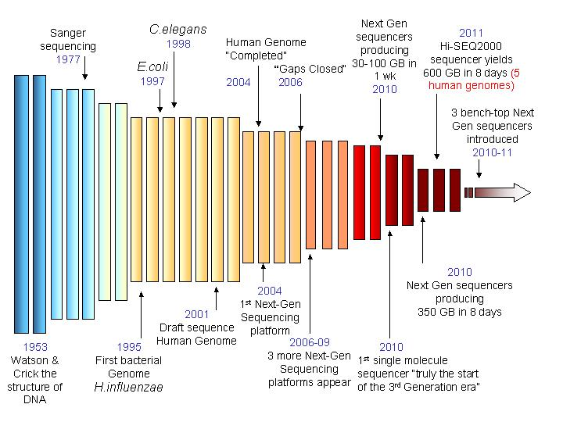
1. Introduction to NGS technology: A bit of history
1st generation
2nd generation
3rd generation
http://www.ipc.nxgenomics.org/newsletter/no11.htm
Notes:
Desde de
1869 – Discovery of DNA
1909 – Chemical characterisation
1953 – Structure of DNA solved
1977 – Sanger sequencing invented
– First genome sequenced – ФX174 (5 kb)
1986 – First automated sequencing machine
1990 – Human Genome Project started
1992 – First “sequencing factory” at TIGR
1995 – First bacterial genome – H. influenzae (1.8 Mb)
1998 – First animal genome – C. elegans (97 Mb)
2003 – Completion of Human Genome Project (3 Gb)
– 13 years, $2.7 bn
2005 – First “next-generation” sequencing instrument
2013– >10,000 genome sequences in NCBI database

Slide 6
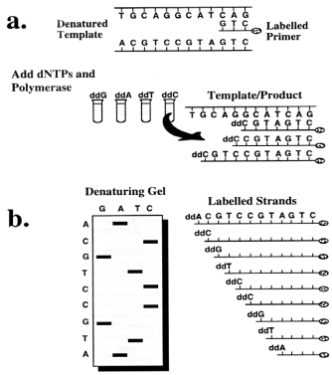
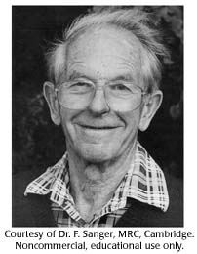
1. Introduction to NGS technology: A bit of history
The sequencing revolution begins…
with F. Sanger (1977)
Chain termination method of DNA sequencing:
based on the selective incorporation of chain terminating dideoxynucleotides by DNA polymerase during in vitro DNA replication.
can only be used for short DNA strands
(100-1000 bp)
Notes:
6

Slide 7
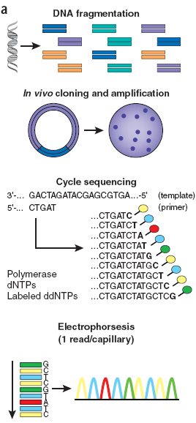
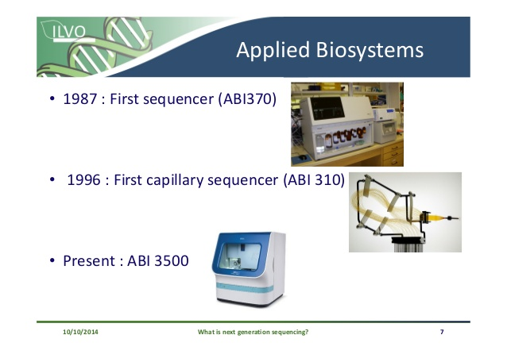
1. Introduction to NGS: First generation sequencing (Sanger method)
Applied Biosystems was the first company to fully automate Sanger sequencing (1995)
Random fragmentation of the DNA into numerous small overlapping segments
- Full genomes can be assembled from the overlapping sequenced segments (reads)
ABI 3500

Slide 8
1. Introduction to NGS: First generation sequencing (Sanger method)
Applied Biosystems was the first company to fully automate Sanger sequencing (1995)
Random fragmentation of the DNA into numerous small overlapping segments
ABI 3500
DNA fragments amplified using cloning vectors
Sequencing by Chain Termination method using fluorescent ddNTPs and capillary electrophoresis
- Allows parallel sequencing of <385 samples in a single run
- Accurate sequencing of <1kb DNA fragments
Used in several sequencing projects (Human Genome Project) and even today for single or low-throughput DNA sequencing

Slide 9
1. Introduction to NGS: First generation sequencing (Sanger method)
Limitations:
Limited speed
Low-throughput
Does not allow the sequencing of complex genomes
Difficulties with automation of sample preparation
Expensive, time consuming
These limitations triggered the efforts to develop new techniques

Slide 10
1. Introduction to NGS: The Next Generation Sequencing revolution
Next Generation Sequencing = High-Throughput Sequencing
Massive parallel sequencing enabled by using micro and nanotechnologies to reduce the size of sample components and reagent costs.
Highly multiplexed, allowing simultaneous sequencing and analysis of millions of samples.
Several different sequencing methods have been developed, all of which are continually being developed at astonishing rates

Slide 11
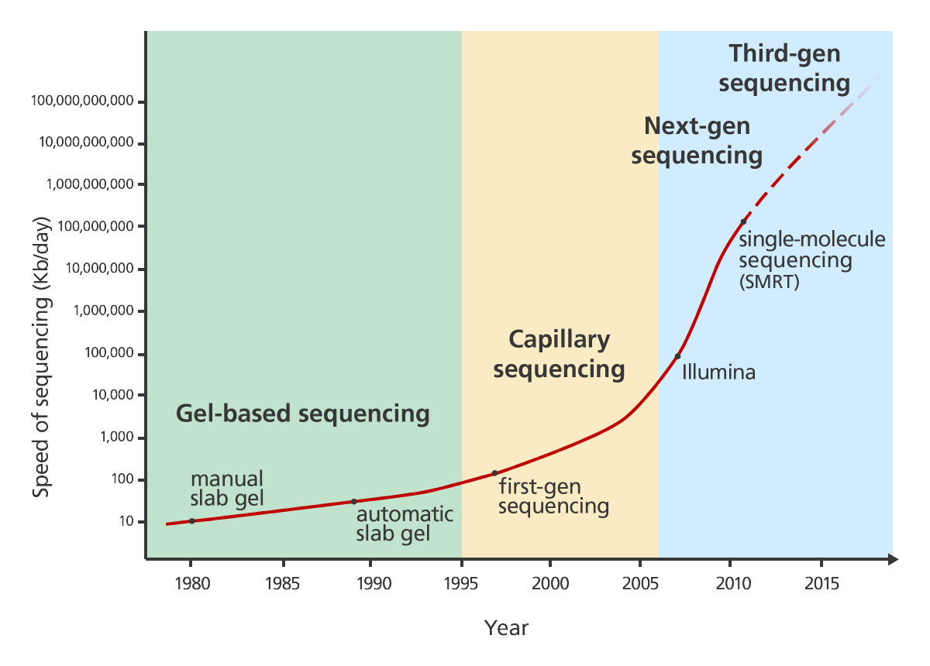
1. Introduction to NGS: The Next Generation Sequencing revolution
Improvements in enzymes, chemistry, technology and imaging dramatically increased sequencing capabilities!
+ Automation
+ Scalable
+ Coverage
Human Genome Project
(3 Gb, – 13 years, $2.7 bn)
>10,000 genome sequences
in NCBI database
http://www.yourgenome.org/stories/third-generation-sequencing
Notes:
11

Slide 12
1. Introduction to NGS: The Next Generation Sequencing revolution
Improvements in enzymes, chemistry, technology and imaging dramatically increased sequencing capabilities!
- Costs
- Time

Slide 13
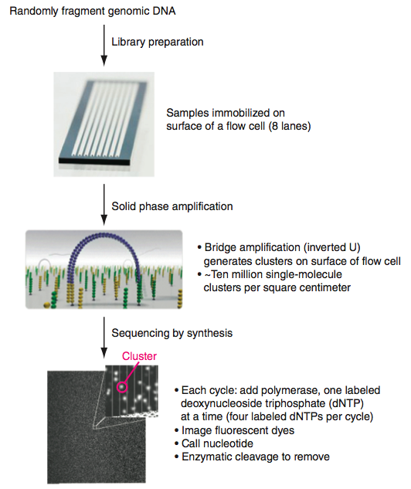
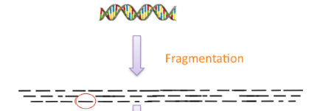
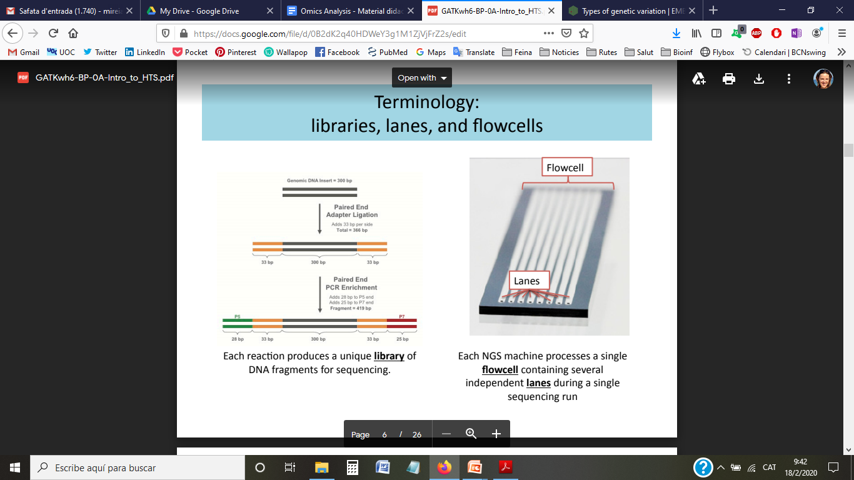
1. Introduction to NGS: Next (2nd) Generation Sequencing
1. Library preparation
Adapters:
Primers for PCR
Anchors for immobilization
Barcodes for multiplexing

Slide 14
1. Introduction to NGS: Next (2nd) Generation Sequencing

Slide 15
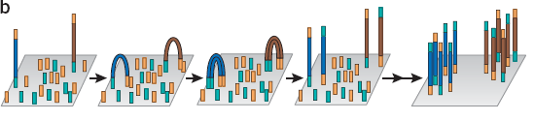
1. Introduction to NGS: Next (2nd) Generation Sequencing
2. PCR-based clonal amplification
Cluster
Clusters of identical DNA fragments are generated through bridge amplification.

Slide 16
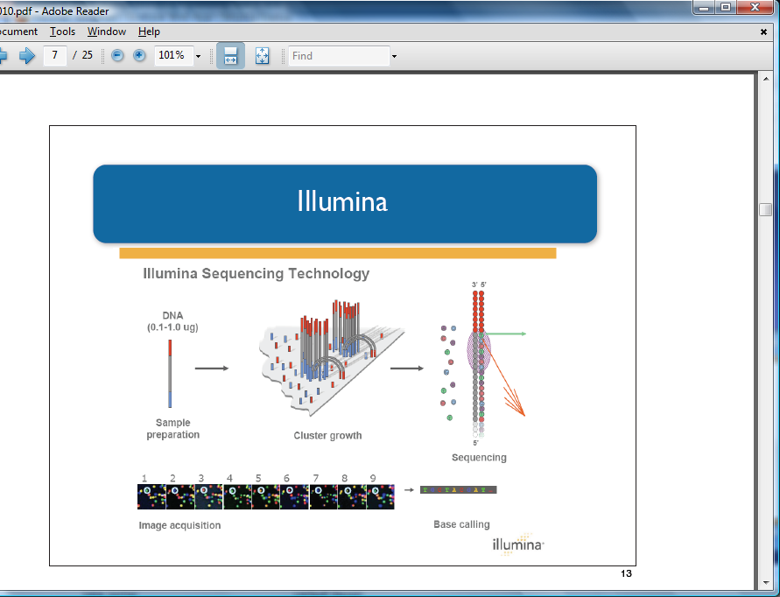
1. Introduction to NGS: Next (2nd) Generation Sequencing
3. Massive parallel sequencing
Sequencing by synthesis using reversible fluorescent dye terminators
Base calling
read

Slide 17
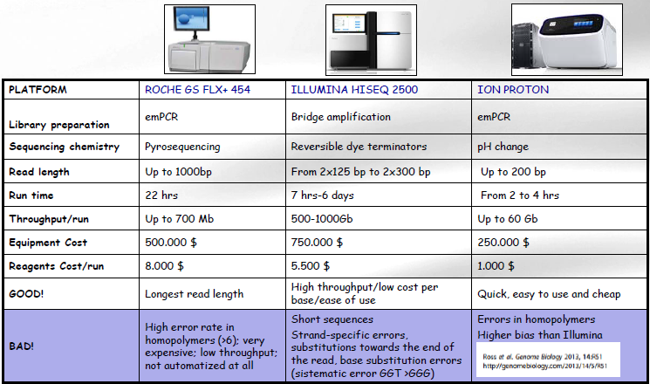
1. Introduction to NGS: Next (2nd) generation sequencing
NGS platform comparison

Slide 18
1. Introduction to NGS: Next (2nd) generation sequencing
Advantages:
No in vivo cloning, transformation, colony picking...
High speed and high-throughput
Cost-effective
High accuray
High sequence coverage
Limitations:
PCR related errors
Short reads
Lack of single molecule sensitivity

Slide 19
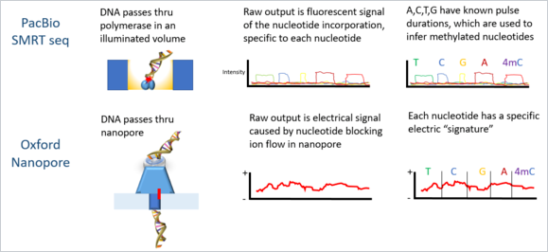
1. Introduction to NGS: 3rd generation sequencing
Next Next Generation Sequencing = Single Molecule Sequencing
Currently under active development
Works by reading the nucleotide sequences at the single molecule level

Slide 20
1. Introduction to NGS: 3rd generation sequencing
Advantages:
No amplification, minimal sample preprocessing
No PCR errors or GC-bias
Single molecule resolution
RNA/DNA seq.
Longer reads
Absolute quantification
Challenges:
-High error rates due to signal noise / molecule instability

Slide 21
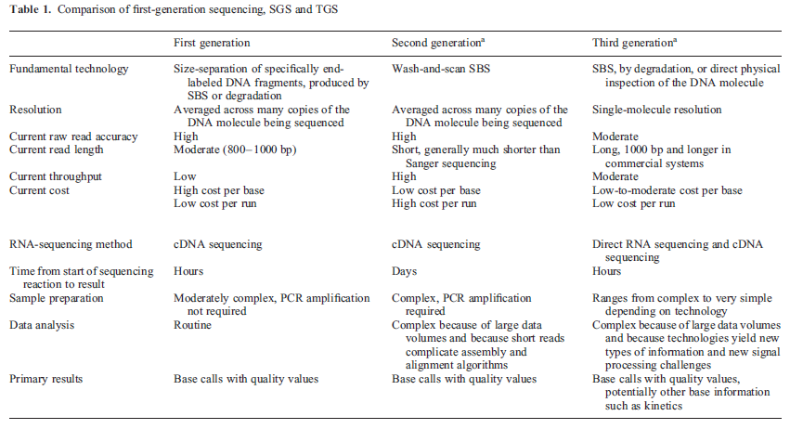

Slide 22
TABLE OF CONTENTS
Introduction to Next Generation Sequencing (NGS) technology
Applications of NGS
Bioinformatics challenges of NGS
Steps in NGS data analysis
Introduction to RNA-seq and Expression analysis
Introduction to Galaxy
RNA-seq analysis exercise with Galaxy
Exercise overview and Input data
Quality Control and pre-processing of raw data
Reads mapping
Summarization to get raw counts
Differential expression analysis (plots, normalization and testing)
Notes:
22

Slide 23
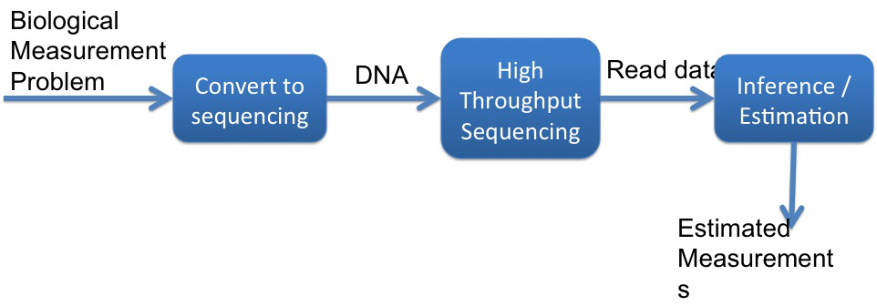
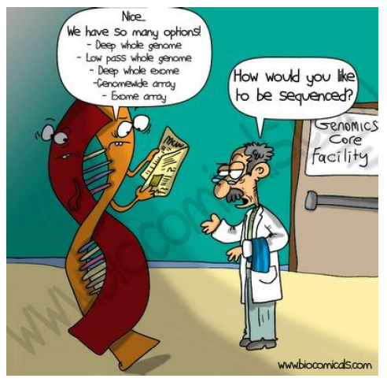
2. Applications of NGS: What can be studied (sequenced)?

Slide 24
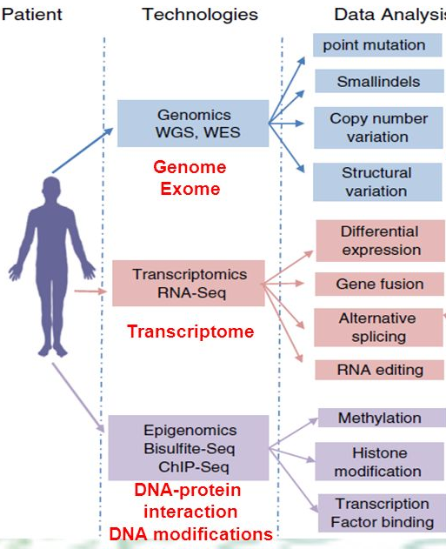
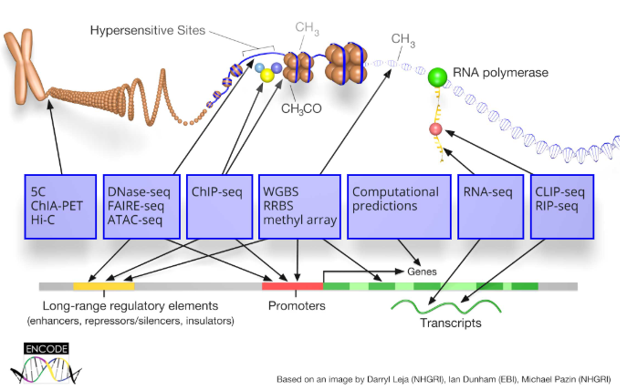
2. Applications of NGS: What can be studied?
But also...
Metagenomics
De novo genome assembly
More info: http://allseq.com/kb-category/applications/

Slide 25
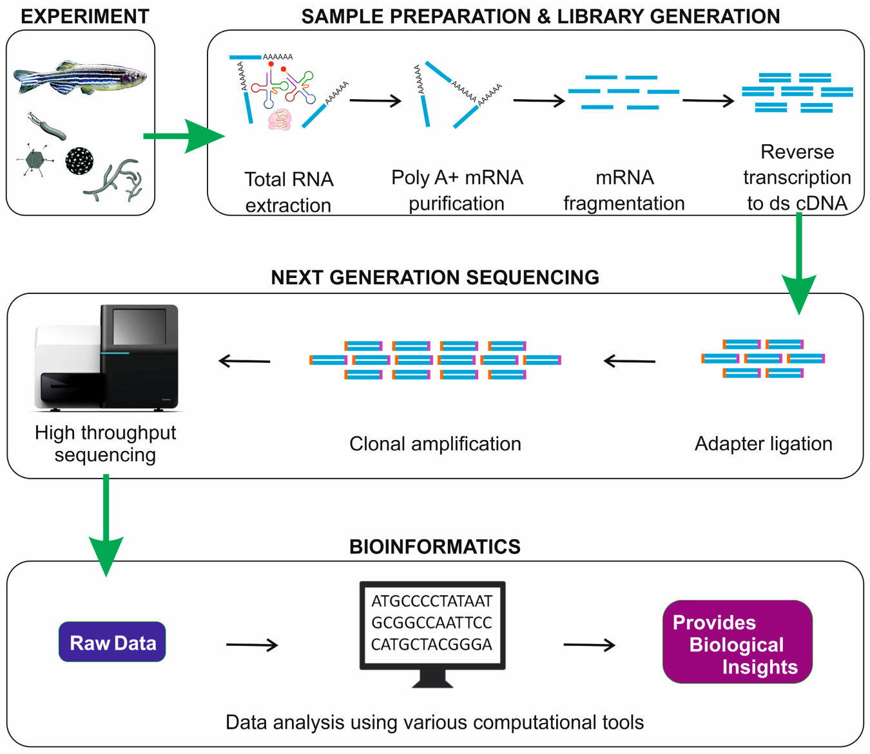
2. Applications of NGS
General pipeline, though application specific

Slide 26
TABLE OF CONTENTS
Introduction to Next Generation Sequencing (NGS) technology
Applications of NGS
Bioinformatics challenges of NGS
Steps in NGS data analysis
Introduction to RNA-seq and Expression analysis
Introduction to Galaxy
RNA-seq analysis exercise with Galaxy
Exercise overview and Input data
Quality Control and pre-processing of raw data
Reads mapping
Summarization to get raw counts
Differential expression analysis (plots, normalization and testing)
Notes:
26

Slide 27
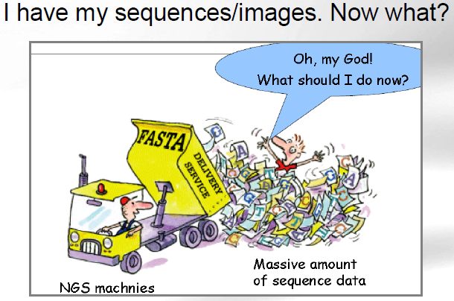
3. Bioinformatics challenges of NGS

Slide 28
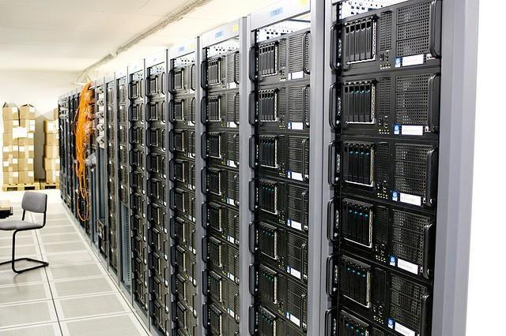
3. Bioinformatics challenges of NGS
A single sequencing experiment can generate 100’s of millions of reads, 10’s to 100’s gigabytes of data.
We need:
Huge data storage and transfer technology
Algorithms for managing, analyzing and visualizing data
Reproducible workflows and standards for analysis
Specialized tools for integrating various data types

Slide 29
TABLE OF CONTENTS
Introduction to Next Generation Sequencing (NGS) technology
Applications of NGS
Bioinformatics challenges of NGS
Steps in NGS data analysis
Introduction to RNA-seq and Expression analysis
Introduction to Galaxy
RNA-seq analysis exercise with Galaxy
Exercise overview and Input data
Quality Control and pre-processing of raw data
Reads mapping
Summarization to get raw counts
Differential expression analysis (plots, normalization and testing)
Notes:
29

Slide 30
4. Steps in NGS data analysis: Terminology
Library – collection of DNA fragments for sequencing
Read – a sequenced fragment
Read length - the average number of contiguous nucleotide bases in a polynucleotide sequence that are produced by a particular sequencing instrument (14-400)
Contig – set of overlapping reads
Sequencing depth/Library size – total number of usable reads from the sequencing machine
Coverage – Number of times a nucleotide base is read (# followed by X: 300X)
Single/Paired end – in paired end sequencing each fragment is sequenced from the two ends and so generates two reads/fragment.
Call – determination of a given base or base sequence by a sequencing instrument

Slide 31
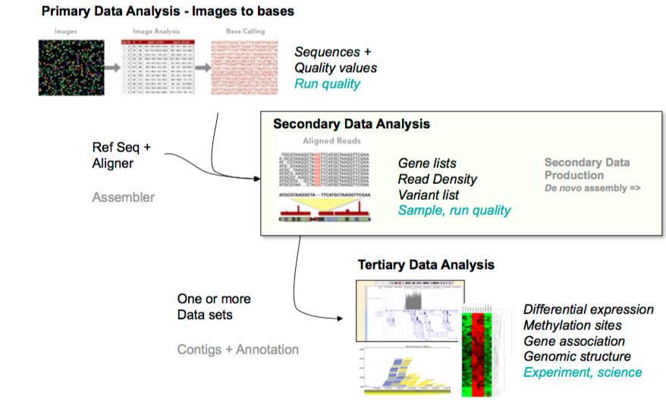
4. Steps in NGS data analysis: Overview

Slide 32
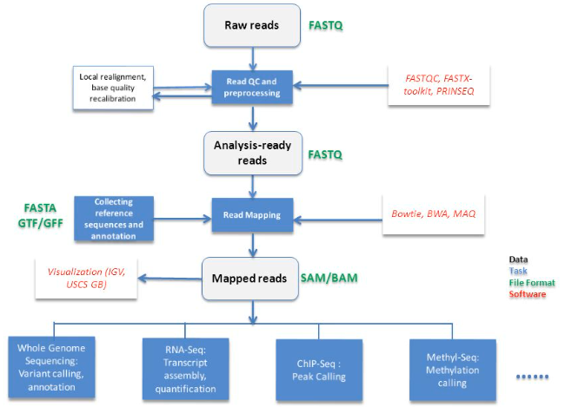
4. Steps in NGS data analysis: Overview
We will have different data (file) formats and tools for each step

Slide 33
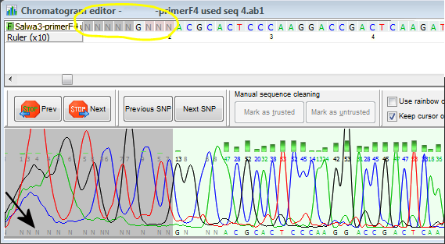
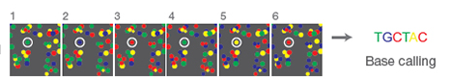
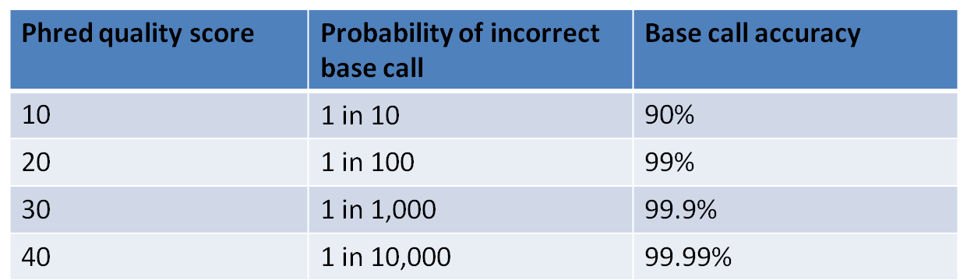
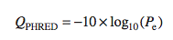
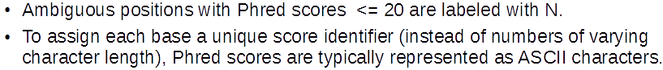
4. Steps in NGS data analysis: Base Calling
Sanger
Illumina (NGS)
Base calling accuracy often measured by the Phred Quality Score (Q score) which assesses the accuracy of a sequencing platform.
It indicates the probability that a given base is called incorrectly by the sequencer.

Slide 34
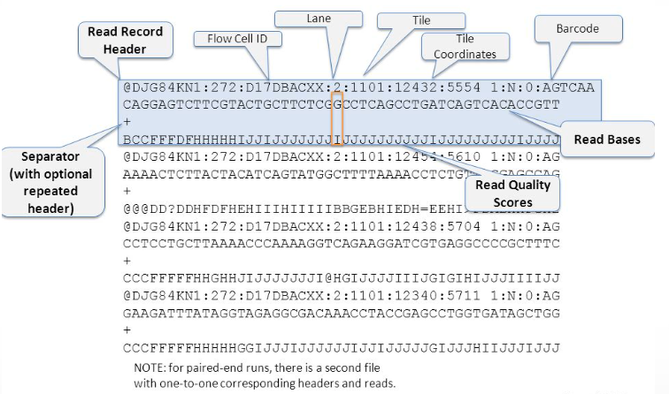
4. Steps in NGS data analysis: FASTQ format for unaligned reads
FASTQ format = DNA sequence data + Phred quality scores of each base

Slide 35
4. Steps in NGS data analysis: Quality Control and Pre-processing of reads

Slide 36
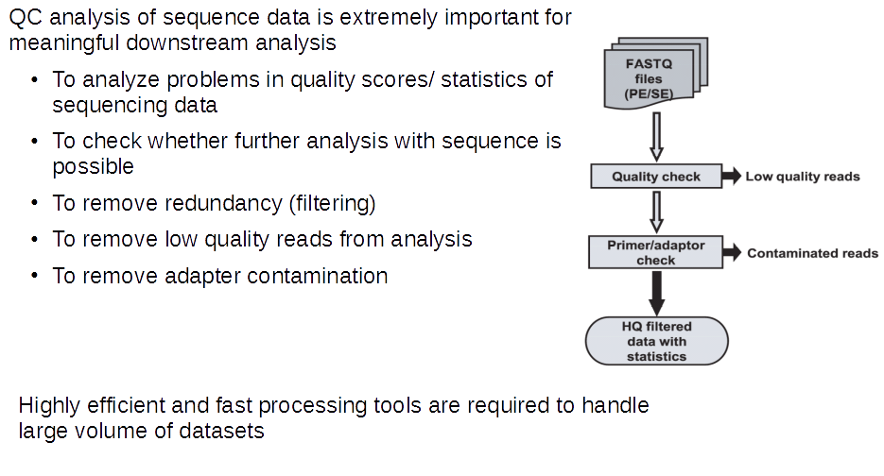
4. Steps in NGS data analysis: Quality Control and Pre-processing of reads

Slide 37
4. Steps in NGS data analysis: Mapping reads to the genome

Slide 38
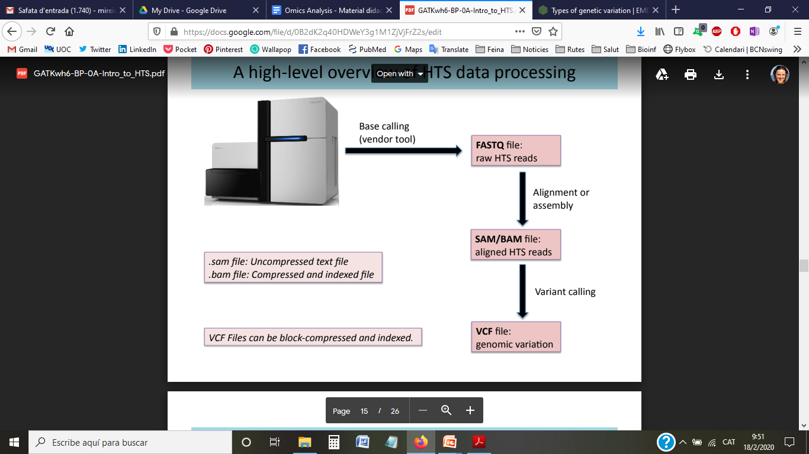
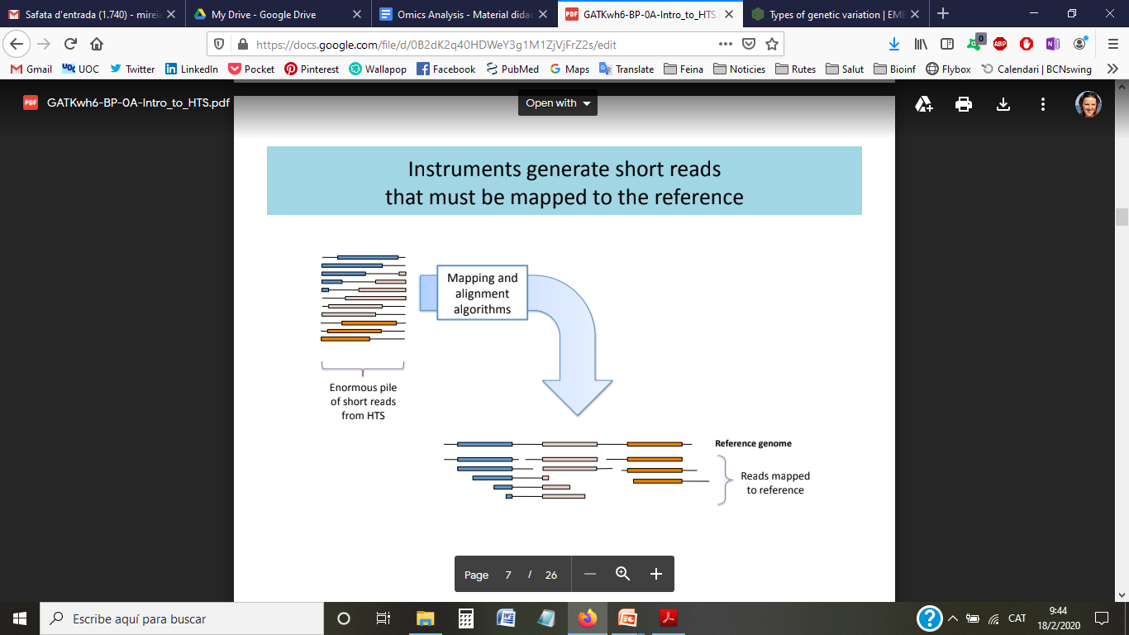
4. Steps in NGS data analysis: Mapping reads to the genome

Slide 39
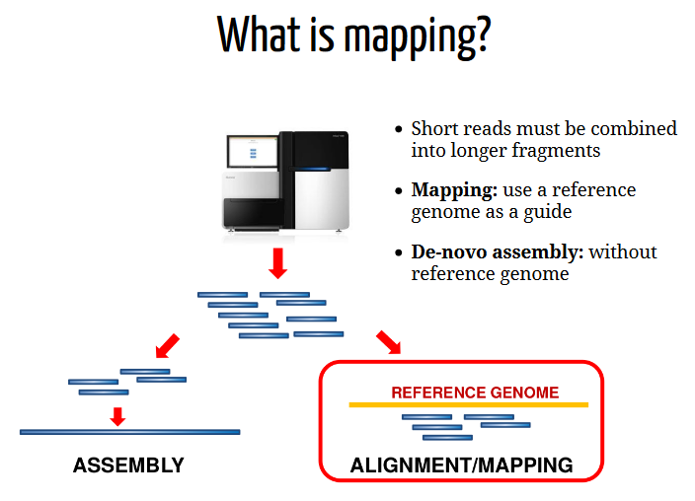
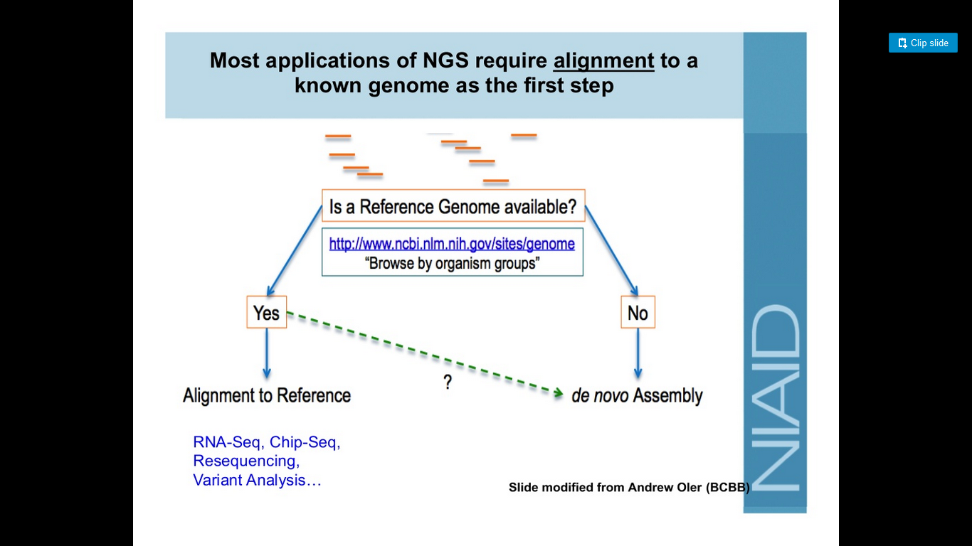
4. Steps in NGS data analysis: Mapping reads to the genome
Mapping/Alignment vs Assembly

Slide 40
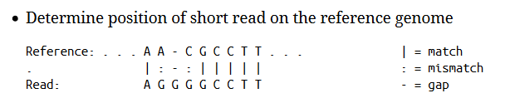
4. Steps in NGS data analysis: Mapping reads to the genome

Slide 41
4. Steps in NGS data analysis: Mapping reads to the genome
Challenging!
There is ambiguity mapping a read with a mismatch versus a deletion

Slide 42
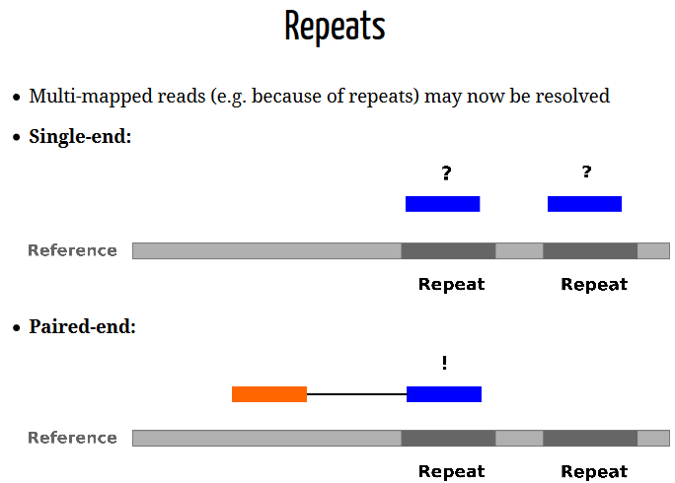
4. Steps in NGS data analysis: Mapping reads to the genome
Challenging!
There is ambiguity mapping a read with a mismatch versus a deletion
A read could align to multiple places (repeats)

Slide 43
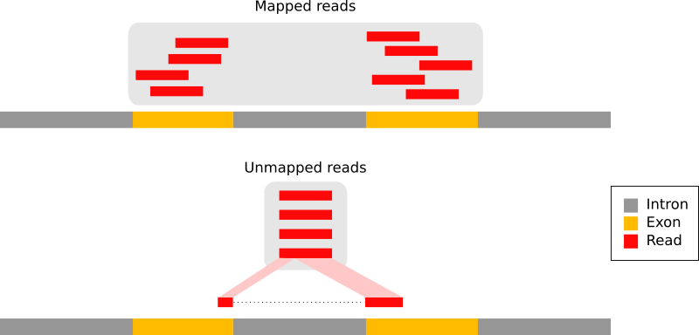
4. Steps in NGS data analysis: Mapping reads to the genome
Challenging!
There is ambiguity mapping a read with a mismatch versus a deletion
A read could align to multiple places (repeats)
In RNA-seq, splicing may split reads

Slide 44
4. Steps in NGS data analysis: Mapping reads to the genome
Challenging!
There is ambiguity mapping a read with a mismatch versus a deletion
A read could align to multiple places (repeats)
In RNA-seq, splicing may split reads
Complex algorithms have been developped
Choose appropriate tool/options
Mapping to the transcriptome instead of genome

Slide 45
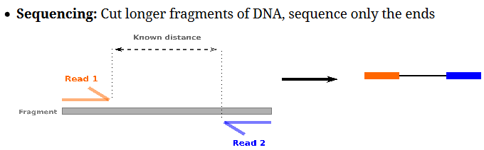
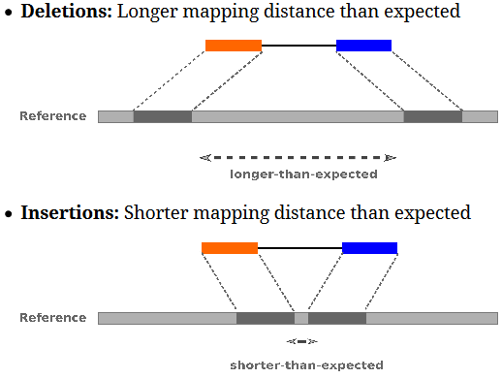
4. Steps in NGS data analysis: Mapping reads to the genome
Paired-end sequencing improves accuracy of mapping

Slide 46
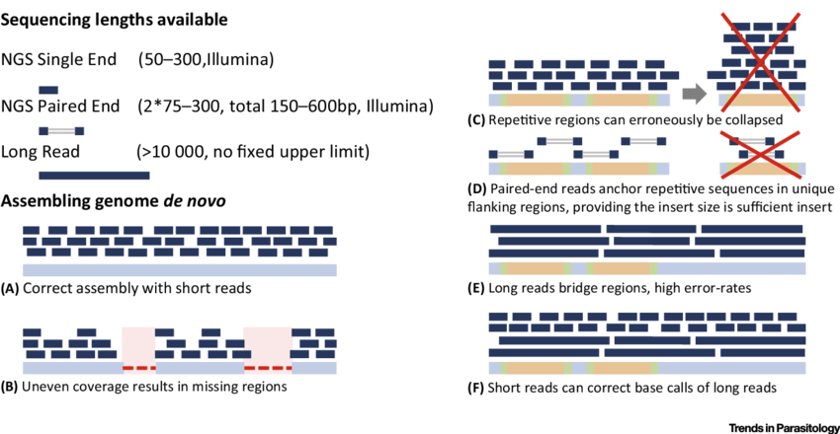
4. Steps in NGS data analysis: Mapping reads to the genome

Slide 47
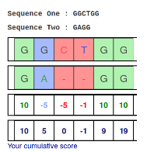
4. Steps in NGS data analysis: Mapping reads to the genome
Mapping quality scores
Quantify the probability that a read is misplaced.
Function of factors such as:
uniqueness (ie not a multi-mapper)
number of mismatches in read
number of insertions/deletions in read
quality of bases in read

Slide 48
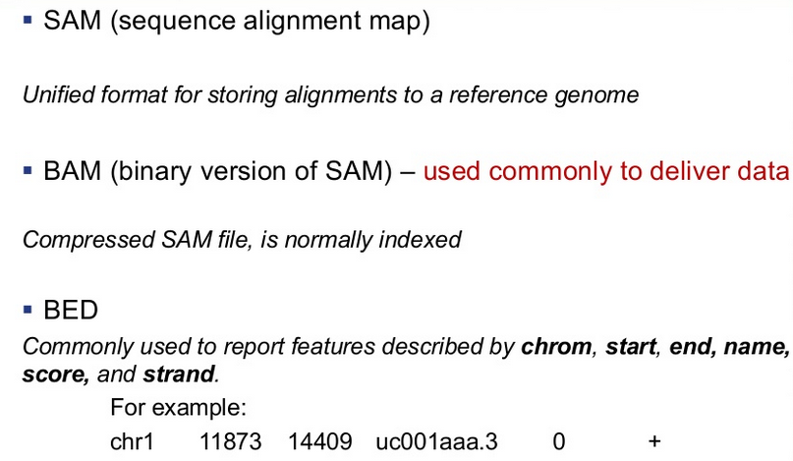
4. Steps in NGS data analysis: Alignment file formats

Slide 49
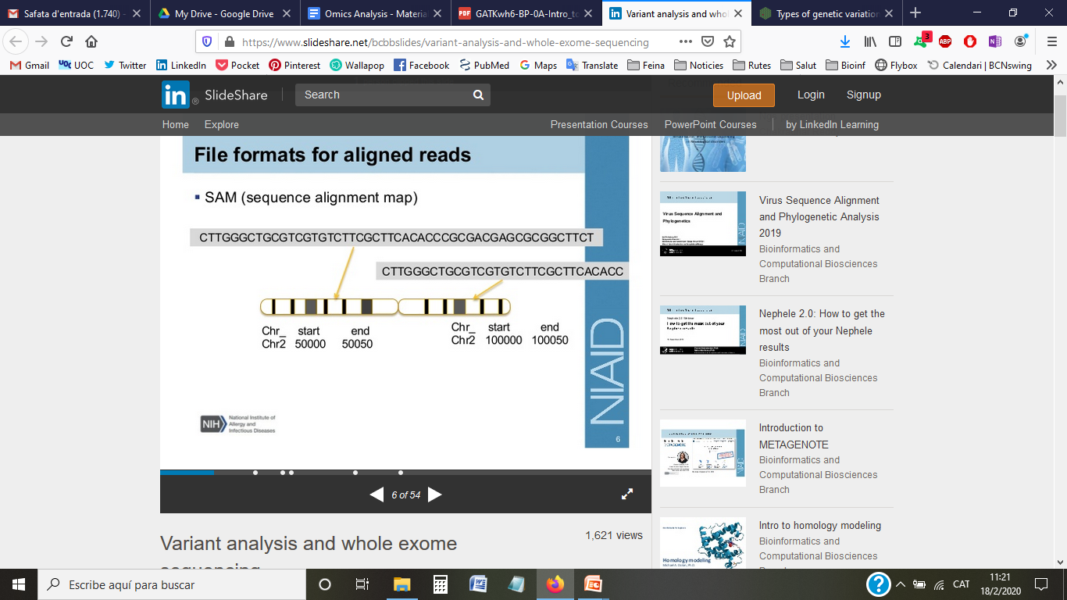
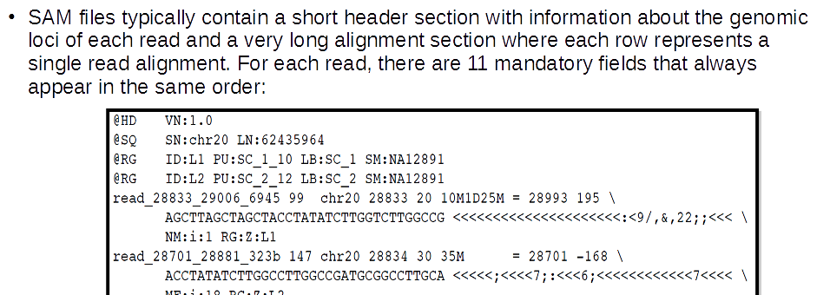
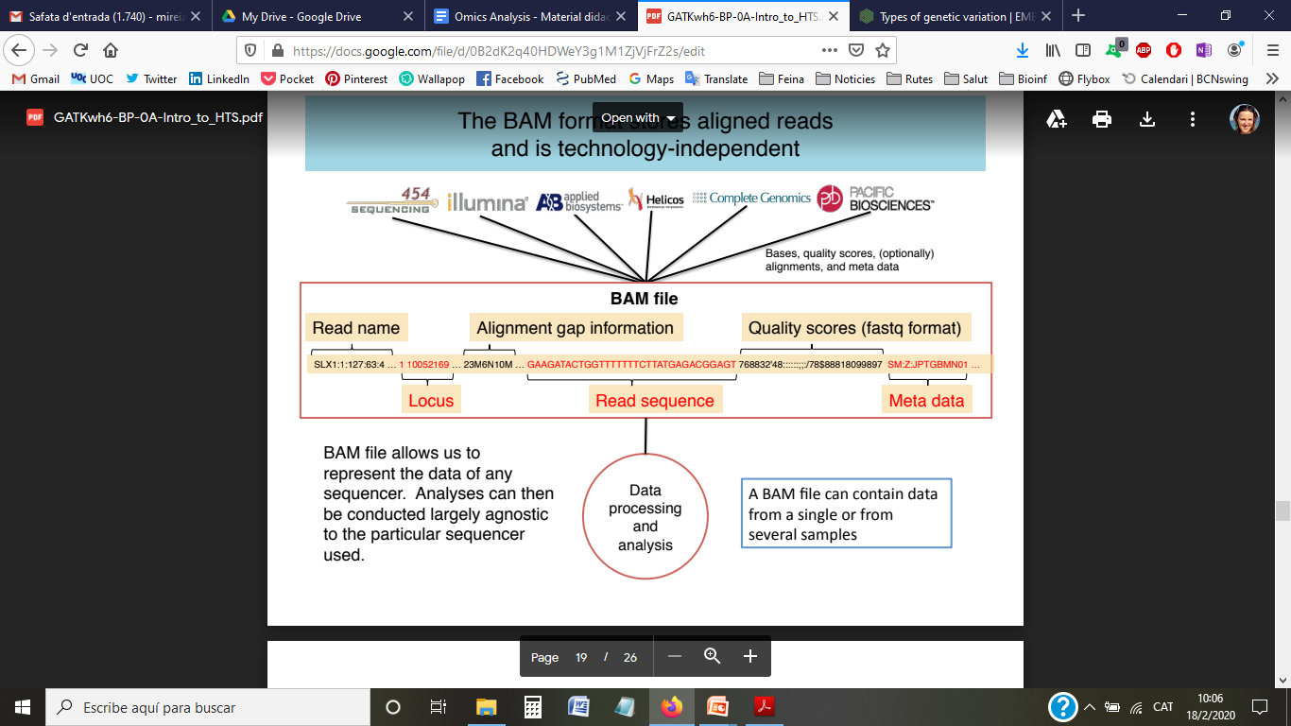
4. Steps in NGS data analysis: BAM/SAM formats for aligned reads
SAM/BAM format = Aligned read sequence + Mapping info (position, quality score...)
header

Slide 50
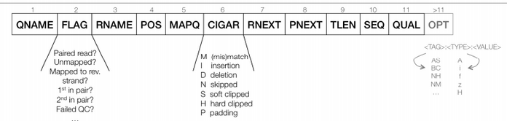
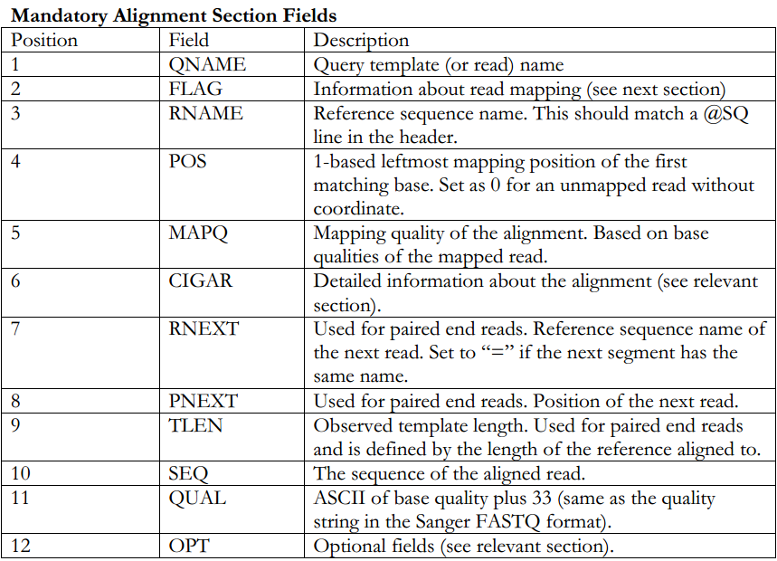
4. Steps in NGS data analysis: BAM/SAM formats for aligned reads
SAM/BAM format

Slide 51
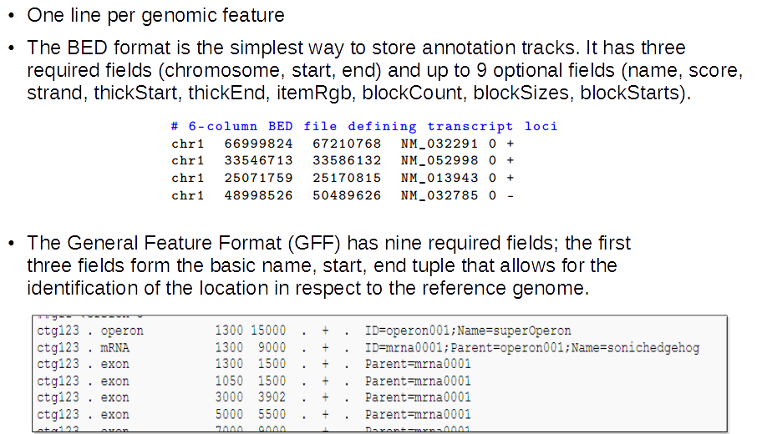
4. Steps in NGS data analysis: Annotation formats
Genome annotations: BED, GFF/GTF formats

Slide 52

4. Steps in NGS data analysis: Annotation formats
Genome annotations: BED, GFF/GTF formats

Slide 53
4. Steps in NGS data analysis: Summary

Slide 54
4. Steps in NGS data analysis: Summary

Slide 55
TABLE OF CONTENTS
Introduction to Next Generation Sequencing (NGS) technology
Applications of NGS
Bioinformatics challenges of NGS
Steps in NGS data analysis
Introduction to RNA-seq and Expression analysis
Introduction to Galaxy
RNA-seq analysis exercise with Galaxy
Exercise overview and Input data
Quality Control and pre-processing of raw data
Reads mapping
Summarization to get raw counts
Differential expression analysis (plots, normalization and testing)
Notes:
55

Slide 56


5. Introduction to RNA-seq: Definition
RNA sequencing (RNA-seq) is the application NGS technologies to study the transcriptome.
RNA transcripts and their abundances capture the dynamic state of a cell at a given time.
Can look at different populations of RNAs, including both coding mRNA and non-coding RNA (eg. miRNA, small RNAs, lincRNAs), ribosome profiling, etc.

Slide 57
5. Introduction to RNA-seq: Benefits and opportunities
Transcript discovery: Which RNA molecules are in my sample?
Novel isoforms and alternative splicing
Non-coding RNAs
RNA quantification: What is the concentration of RNAs?
Relative gene expression (within sample)
Differential expression (between biological samples)
Identify allele specific expression patterns
Gene fusion
Detect expressed SNPs or mutations
RNA editing
Post-transcriptional modifications

Slide 58

5. Introduction to RNA-seq: Benefits and opportunities
Recent advances in RNA-Seq include single cell sequencing and in situ sequencing of fixed tissue.

Slide 59

5. Introduction to RNA-seq: How it works
A sequencing library is prepared from cDNA, obtained by reverse transcription of the RNA.
Some purification steps may be carried out to enrich for the RNA species of interest
Sequence reads may be aligned with the reference genome/transcriptome

Slide 60


5. Introduction to RNA-seq: Expression analysis
Gene expression profiling is achieved by sequencing every mRNA molecule and counting the number of times the transcripts have been sequenced.
Sequence reads are aligned with the reference genome/transcriptome and used to generate a base-resolution expression profile for each gene.
Aligned reads are summarised and count over some biologically meaningful unit, such as exons, transcripts, genes…
The summarized RNA-seq data is widely known as a count table.
summarize & count

Slide 61


5. Introduction to RNA-seq: Expression analysis
Microarray
RNA-seq
Analog signal, continuous (intensity)
High background noise
Cross-hybridization bias
Range of detection limited by background and signal saturation
Sequence must be known
Only see what’s on the chip
Well established methods for analysis
Small data demands
Lower costs
Digital signal, discrete (read counts)
Weak background or no noise
Unbiased detection (though may be GC biases, mapping ambiguities)
Higher reproducibility
Wider range of detection, sensitivity limited by depth of sequencing (library size)
No prior knowledge of transcript seq. needed → discovery, rare genes, non-model organisms
Single-base resolution → SNPs, isoforms
Complex analysis
High data storage & computational demands
Higher costs
Notes:
61

Slide 62
5. Introduction to RNA-seq Expression Analysis: Main challenges
Sample
RNA is fragile compared to DNA
Purity? Quantity? Quality?
RNA subtype selection
Small RNAs captured separately
PolyA selection of large RNAs may result in 3’ end bias
A small fraction of highly expressed genes may consume the majority of reads (rRNA)
Library preparation
Technical biases
Contaminating sequences (adapters..)
Sequencing depth (library size)
The relative abundance of RNAs vary widely (10⁵ – 10⁷ orders of magnitude)
Range of detection

Slide 63

5. Introduction to RNA-seq Expression Analysis: Main challenges
Mapping reads to genome is challenging
RNAs consist of small exons that may be separated by large introns
Non-uniformity coverage of the genome
Reads may align to multiple positions
Feature summarization and counting
Need for reference annotations
Read counts are affected by factors such as transcript length (longer transcripts have higher read counts, at the same expression level) and total number of reads (sequencing depth).

Slide 64

5. Introduction to RNA-seq Expression Analysis: Workflow and data formats
Sequencing
Raw sequence reads
(.FASTQ file)
QC
Ref. genome
(.FA file)
Mapping/
Alignment
Aligned reads
(.SAM/BAM file)
Genome annotations
(.GFF file)
QC
Summarize
& Count
Counts table
(.TXT file)
Differential expression analysis

Slide 65

5. Introduction to RNA-seq Expression Analysis: Workflow
Differential expression analysis

Slide 66
TABLE OF CONTENTS
Introduction to Next Generation Sequencing (NGS) technology
Applications of NGS
Bioinformatics challenges of NGS
Steps in NGS data analysis
Introduction to RNA-seq and Expression analysis
Introduction to Galaxy
RNA-seq analysis exercise with Galaxy
Exercise overview and Input data
Quality Control and pre-processing of raw data
Reads mapping
Summarization to get raw counts
Differential expression analysis (plots, normalization and testing)
Notes:
66

Slide 67


6. Introduction to Galaxy
https://www.bioconductor.org/

Slide 68
6. Introduction to Galaxy
www.galaxyproject.org
An open, web-based platform integrating many popular tools and resources for intensive biomedical research.
What can be done?
Obtain data from many data sources, or your own data
Prepare data for further analysis by rearranging or cutting data columns, filtering data and many other options
Analyze data by finding overlapping regions, determining statistics, preprocessing NGS data and much more
Share data and workflows
European server: https://usegalaxy.eu/
US server: https://usegalaxy.org/

Slide 69

6. Introduction to Galaxy

Slide 70

6. Introduction to Galaxy
Can create workflows with all the analysis steps, allowing users to repeat analysis with different dataset and high reproducibility

Slide 71

6. Introduction to Galaxy
Register for a Galaxy account
(https://usegalaxy.eu/)
This will only take a moment, and will allow all the work that you do to persist between sessions and allow you to name, save, share, and publish Galaxy histories, workflows, datasets and pages. It allows you to store up to 250GB of data on this public server.

Slide 72
TABLE OF CONTENTS
Introduction to Next Generation Sequencing (NGS) technology
Applications of NGS
Bioinformatics challenges of NGS
Steps in NGS data analysis
Introduction to RNA-seq and Expression analysis
Introduction to Galaxy
RNA-seq analysis exercise with Galaxy
Exercise overview and Input data
Quality Control and pre-processing of raw data
Reads mapping
Summarization to get raw counts
Differential expression analysis (plots, normalization and testing)
Notes:
72

Slide 73

7. RNA-seq analysis exercise with Galaxy: Study overview
Objective: We want to identify genes differentially expressed in the lactating versus pregnant mammary gland
Dataset: RNA-seq data of mouse mammary gland (GSE60450)
Note1: we are going to be working with a small part of the FASTQ files (1000 reads from each sample) to enable running through all the steps quickly.
Note2: two biological replicates are used here, however three replicates is usually recommended as a minimum requirement for RNA-seq.

Slide 74
7. RNA-seq analysis exercise with Galaxy: Study overview
Before beginning with the analysis we need some information:
Which organism has been sequenced?
What are we measuring?
With which platform was the sequencing performed?
What type of analysis we need to perform to answer the question of study?
What are the experimental conditions (Groups) to compare?
What are the input files we need to begin the analysis?
Single-end? Paired-end?
Let’s begin…
What’s the first step in the analysis workflow?
Notes:
74

Slide 75




Slide 76
7. RNA-seq analysis exercise with Galaxy: Study overview
2 cell types
3 gestational stages
6 Groups:
Basal.Virgin
Basal.Pregnant
Basal.Lactating
Luminal.Virgin
Luminal.Pregnant
Luminal.Lactating
We will analyze the following comparisons:
Basal.Lactating vs. Basal.Pregnant
Luminal.Lactating vs. Luminal.Pregnant

Slide 77
7. RNA-seq analysis exercise with Galaxy: Input data
Sequencing
Raw sequence reads
(.FASTQ file)
QC
Ref. genome
(.FA file)
Mapping/
Alignment
Aligned reads
(.SAM/BAM file)
Genome annotations
(.GFF file)
QC
Summarize
& Count
Counts table
(.TXT file)
Differential expression analysis

Slide 78
7. RNA-seq analysis exercise with Galaxy: Upload input data
The links to the FASTQ files are provided below:
SampleID Group URL
MCL1-DL basallactate https://ndownloader.figshare.com/files/5053573?private_link=f5d63d8c265a05618137 MCL1-DK basallactate https://ndownloader.figshare.com/files/5053570?private_link=f5d63d8c265a05618137 MCL1-DJ basalpregnant https://ndownloader.figshare.com/files/5053567?private_link=f5d63d8c265a05618137 MCL1-DI basalpregnant https://ndownloader.figshare.com/files/5053564?private_link=f5d63d8c265a05618137 MCL1-DH basalvirgin https://ndownloader.figshare.com/files/5053561?private_link=f5d63d8c265a05618137 MCL1-DG basalvirgin https://ndownloader.figshare.com/files/5053558?private_link=f5d63d8c265a05618137 MCL1-LF luminalvirgin https://ndownloader.figshare.com/files/5053555?private_link=f5d63d8c265a05618137 MCL1-LE luminalvirgin https://ndownloader.figshare.com/files/5053588?private_link=f5d63d8c265a05618137 MCL1-LD luminalpregnant https://ndownloader.figshare.com/files/5053579?private_link=f5d63d8c265a05618137 MCL1-LC luminalpregnant https://ndownloader.figshare.com/files/5053582?private_link=f5d63d8c265a05618137 MCL1-LB luminalvirgin https://ndownloader.figshare.com/files/5053585?private_link=f5d63d8c265a05618137 MCL1-LA luminalvirgin https://ndownloader.figshare.com/files/5053552?private_link=f5d63d8c265a05618137
Notes:
78

Slide 79

7. RNA-seq analysis exercise with Galaxy: Upload input data
Notes:
79

Slide 80

7. RNA-seq analysis exercise with Galaxy: Upload input data
We are going to import the files into a Collection. Using Galaxy Collections helps keep the datasets organised and tidy in the history.
Copy urls here

Slide 81

7. RNA-seq analysis exercise with Galaxy: Upload input data
You should see a collection (list) called fastqs in your history containing all 12 FASTQ files.

Slide 82

7. RNA-seq analysis exercise with Galaxy: View uploaded files
Decipher some information?
Notes:
82

Slide 83
TABLE OF CONTENTS
Introduction to Next Generation Sequencing (NGS) technology
Applications of NGS
Bioinformatics challenges of NGS
Steps in NGS data analysis
Introduction to RNA-seq and Expression analysis
Introduction to Galaxy
RNA-seq analysis exercise with Galaxy
Exercise overview and Input data
Quality Control and pre-processing of raw data
Reads mapping
Summarization to get raw counts
Differential expression analysis (plots, normalization and testing)
Notes:
83

Slide 85
Quality Control

Slide 86

7. RNA-seq analysis exercise with Galaxy: Quality control with FastQC
Notes:
86

Slide 87

7. RNA-seq analysis exercise with Galaxy: Quality control with FastQC

Slide 88

7. RNA-seq analysis exercise with Galaxy: Quality control with FastQC
FastQC
Per base sequence quality (Boxplot)
Y axis- Quality Score
X axis- Base position

Slide 89

7. RNA-seq analysis exercise with Galaxy: Quality control with FastQC
FastQC
Per base sequence quality (Boxplot)

Slide 90



7. RNA-seq analysis exercise with Galaxy: Quality control with FastQC
FastQC
Per sequence quality scores

Slide 91



7. RNA-seq analysis exercise with Galaxy: Quality control with FastQC
FastQC
Per base sequence content

Slide 92



7. RNA-seq analysis exercise with Galaxy: Quality control with FastQC
FastQC
Per sequence GC content

Slide 93

7. RNA-seq analysis exercise with Galaxy: Quality control with FastQC
FastQC
Per base N content

Slide 94

7. RNA-seq analysis exercise with Galaxy: Quality control with FastQC
FastQC
Sequence length distribution

Slide 95

7. RNA-seq analysis exercise with Galaxy: Quality control with FastQC
FastQC
Sequence duplication level

Slide 96

7. RNA-seq analysis exercise with Galaxy: Quality control with FastQC
FastQC
Overrepresented sequences

Slide 97

7. RNA-seq analysis exercise with Galaxy: Quality control with FastQC
FastQC
Adapter content

Slide 98
7. RNA-seq analysis exercise with Galaxy: Quality control with FastQC
FastQC
Good (Illumina) quality data:
http://www.bioinformatics.babraham.ac.uk/projects/fastqc/good_sequence_short_fastqc.html
Bad (Illumina) quality data:
http://www.bioinformatics.babraham.ac.uk/projects/fastqc/bad_sequence_fastqc.html

Slide 99
7. RNA-seq analysis exercise with Galaxy: Quality control with FastQC
Your turn!
Do we have good data?
What would be the next step in the analysis workflow?

Slide 100

7. RNA-seq analysis exercise with Galaxy: Quality control with FastQC
We can aggregate FastQC results using MultiQC tool:

Slide 101



7. RNA-seq analysis exercise with Galaxy: Quality control with FastQC
The results obtained for the full dataset:
The base quality is high in all samples.
Some Illumina adapter has been detected.
Some duplication in RNA-seq can be normal due to the presence of highly expressed genes.

Slide 102

7. RNA-seq analysis exercise with Galaxy: Pre-processing of raw data
Based on the information provided by the QC graphs, the sequences may be treated to reduce bias in downstream analysis:
Filtering sequences
with low mean quality score
too short
with too many ambiguous (N) bases
based on their GC content
Biological contamination: polyA-tails, rRNA or mtDNA sequences,…
Technical contamination: PhiX internal control sequences, adapters/primers
Removing duplicate reads is not advised since high expressed genes can have genuine duplicate reads that are not due to the PCR amplification step.
Cutting/Trimming sequences
from low quality score regions
beginning/end of sequence
removing adapters, primers
When preprocessing paired-end data coming from separate files, this must be taken into account so that reads are preprocessed “in pairs”

Slide 103

7. RNA-seq analysis exercise with Galaxy: Pre-processing of raw data
Filter reads with Cutadapt tool:
Trim the standard Illumina adapter AGATCGGAAGAGCACACGTCTGAACTCCAGTCAC
Quality cutoff: 20
Minimum read length: 20

Slide 104


7. RNA-seq analysis exercise with Galaxy: Pre-processing of raw data
After trimming, we can run the FastQC on the trimmed reads and check that:
No adapter is detected now.
The reads are no longer all the same length, we now have sequences of different lengths detected.

Slide 105
TABLE OF CONTENTS
Introduction to Next Generation Sequencing (NGS) technology
Applications of NGS
Bioinformatics challenges of NGS
Steps in NGS data analysis
Introduction to RNA-seq and Expression analysis
Introduction to Galaxy
RNA-seq analysis exercise with Galaxy
Exercise overview and Input data
Quality Control and pre-processing of raw data
Reads mapping
Summarization to get raw counts
Differential expression analysis (plots, normalization and testing)
Notes:
105

Slide 106

7.3 RNA-seq data analysis. Reads Mapping

Slide 107

7.3 RNA-seq data analysis. Reads Mapping
https://galaxyproject.github.io/training-material/topics/sequence-analysis/tutorials/mapping/tutorial.html
Main issues
Number of allowed mismatches
Number of multi-hits
Considering exon junctions

Slide 108


7.3 RNA-seq data analysis. Reads Mapping
What to map to?
Map to the genome, with knowledge of transcript annotations
• Well annotated genome reference is required.
• To eﬀectively map to exon junctions, you need a mapping algorithm that can divide the sequencing reads and map portions independently
• Identifying alternative transcript isoforms involves complex algorithms

Slide 109
7.3 RNA-seq data analysis. Reads Mapping
Which sequence mappers to use?
• RNASeq Alignment algorithm must be
Fast
Able to handle SNPs, indels, and sequencing errors
Maintain accurate quantiﬁcation
Allow for introns for reference genome alignment (spliced alignment detection)

Slide 110
7.3 RNA-seq data analysis. Reads Mapping
Which sequence mappers to use?
• RNASeq Alignment algorithm must be
Fast
Able to handle SNPs, indels, and sequencing errors
Maintain accurate quantiﬁcation
Allow for introns for reference genome alignment (spliced alignment detection)
• Burrows-Wheeler Transform (BWT) mappers
Fast
Limited mismatches allowed (<3)
Limited indel detection ability
Examples: Bowtie2, BWA, Tophat, HISAT2
Use cases: large and conserved genome and transcriptomes
• Hash Table mappers
Require large amount of RAM for indexing
More mismatches allowed
Indel detection
Examples: GSNAP, SHRiMP, STAR
Use case: highly variable or smaller genomes, transcriptomes

Slide 111

7.3 RNA-seq data analysis. Reads Mapping
Alignment-independent quantification for RNA-Seq
Alignment steps are computationally heavy and can be very time-consuming even with multi-threading.
In 2014, Sailfish method, demonstrated that it was not necessary to actually align each read to the genome in order to obtain accurate transcript each read.
https://cgatoxford.wordpress.com/2015/10/12/road-testing-kallisto/

Slide 112
7.3 RNA-seq data analysis. Reads Mapping
Alignment-independent quantification for RNA-Seq
Alignment steps are computationally heavy and can be very time-consuming even with multi-threading.
In 2014, Sailfish method, demonstrated that it was not necessary to actually align each read to the genome in order to obtain accurate transcript each read.
shredding the transcriptome and reads into kmers (short overlapping sequences
matching the transcriptome and read kmers (is a very fast and low memory usage)
https://cgatoxford.wordpress.com/2015/10/12/road-testing-kallisto/

Slide 113
7.3 RNA-seq data analysis. Reads Mapping
Alignment-independent quantification for RNA-Seq
Nowadays there exist various tools:
Salmon, Kallisto, Sailfish
PROS:
Extremely Fast & Lightweight (can quantify 20 million reads in five minutes on a laptop computer)
Easy to use

Slide 114



7.3 RNA-seq data analysis. Reads Mapping
Alignment-independent quantification for RNA-Seq
Nowadays there exist various tools:
Salmon, Kallisto, Sailfish
PROS:
Extremely Fast & Lightweight (can quantify 20 million reads in five minutes on a laptop computer)
Easy to use

Slide 115

7.3 RNA-seq data analysis. Reads Mapping

Slide 116

7.3 RNA-seq data analysis. Reads Mapping
We will use the existing reference genome for mouse: mm10/GRCm38
We will use HISAT2 to align the reads
We are only using a subset of 1000 reads per sample (aligning step will take less than the full set)
https://daehwankimlab.github.io/hisat2/

Slide 117

7.3 RNA-seq data analysis. Reads Mapping

Slide 118





7.3 RNA-seq data analysis. Reads Mapping (view summary)

Slide 119
7.3 RNA-seq data analysis. Reads Mapping (View BAM files)

Slide 120


7.3 RNA-seq data analysis. Reads Mapping (View BAM files)

Slide 121

7.3 RNA-seq data analysis. Reads Mapping (View BAM files)

Slide 122


7.3 RNA-seq data analysis. Reads Mapping (download BAM files)
Note that for BAM files the .bai indexes (required for IGV) will be included automatically in the download.

Slide 123


7.3 RNA-seq data analysis. Reads Mapping (check the mapping)

Slide 124



7.3 RNA-seq data analysis. Reads Mapping (check the mapping)

Slide 125


7.3 RNA-seq data analysis. Reads Mapping (QC mapped reads)

Slide 126


7.3 RNA-seq data analysis. Reads Mapping (QC duplicate reads)

Slide 127

7.3 RNA-seq data analysis. Reads Mapping (QC duplicate reads)

Slide 128


7.3 RNA-seq data analysis. Reads Mapping (QC duplicate reads)

Slide 129
TABLE OF CONTENTS
Introduction to Next Generation Sequencing (NGS) technology
Applications of NGS
Bioinformatics challenges of NGS
Steps in NGS data analysis
Introduction to RNA-seq and Expression analysis
Introduction to Galaxy
RNA-seq analysis exercise with Galaxy
Exercise overview and Input data
Quality Control and pre-processing of raw data
Reads mapping
Summarization to get raw counts
Differential expression analysis (plots, normalization and testing)
Notes:
129

Slide 130


7.4 Summarization and Raw counts
Summarize and aggregate reads over some biologically meaningful unit, such as exons, transcripts, genes, regions …
Many methods available
Counts # of reads overlapping the exons in a gene,
Include reads along the whole length of the gene and thereby incorporate reads from “introns”
Include only reads that map to coding sequence

Slide 131
7.4 Summarization and Raw counts
The alignment produces a set of BAM files, where each file contains the read alignments for each sample.
In the BAM file, there is a chromosomal location for every read that mapped.
We need to summarise the information across genes or exons.
featureCounts requires gene annotation specifying the genomic start and end position of each exon of each gene.
Reads that map to exons of genes are added together to obtain the count for each gene
For other species, users will need to read in a data frame in GTF format to define the genes and exons.

Slide 132

7.4 Summarization and Raw counts
The summarized RNA-seq data is widely known as count table

Slide 133
7.4 Summarization and Raw counts
The summarized RNA-seq data is widely known as count table

Slide 134

7.4 Summarization and Raw counts

Slide 135

7.4 Summarization and Raw counts

Slide 136

7.4 Summarization and Raw counts (QC of read counts)

Slide 137


7.4 Summarization and Raw counts (QC of read counts)

Slide 138

7.4 Summarization and Raw counts (create count matrix)

Slide 139


7.4 Summarization and Raw counts (create count matrix)

Slide 140
TABLE OF CONTENTS
Introduction to Next Generation Sequencing (NGS) technology
Applications of NGS
Bioinformatics challenges of NGS
Steps in NGS data analysis
Introduction to RNA-seq and Expression analysis
Introduction to Galaxy
RNA-seq analysis exercise with Galaxy
Exercise overview and Input data
Quality Control and pre-processing of raw data
Reads mapping
Summarization to get raw counts
Differential expression analysis (plots, normalization and testing)
Notes:
140

Slide 141
7.5 Differential Expression Analysis
Statistical inference of differential expression
Class comparison problem:
Identify genes whose expression is significantly associated with different conditions:
Treatment, cell type …
Dose, time,….
Indirect comparisons: 2 groups
E.g. 10 individuals: 5 suffer diabetes, 5 healthy
One sample from each individual
Test: Two sample t-test
Notes:
Targets file normalmente csv. Lo haríamos con un excel o libre office, etc y se grabaría en csv
Cel files en una carpeta determinada

Slide 142
7.5 Differential Expression Analysis
High number of variables to analyze High number of test to perform
Multiple testing problem: It is needed to control for the type I error (false positives). FALSE DISCOVERY RATE
Finally we will be assigning a p-value for each test/gene.
Notes:
Targets file normalmente csv. Lo haríamos con un excel o libre office, etc y se grabaría en csv
Cel files en una carpeta determinada

Slide 143
7.5 Differential Expression Analysis
We will use three files for this analysis:
Count matrix (genes in rows, samples in columns)
Sample information file (sample id, group)
Gene annotation file (gene id, symbol, description)
Notes:
Targets file normalmente csv. Lo haríamos con un excel o libre office, etc y se grabaría en csv
Cel files en una carpeta determinada

Slide 144

7.5 Differential Expression Analysis
https://ndownloader.figshare.com/files/5057929?private_link=1d788fd384d33e913a2a
https://ndownloader.figshare.com/files/5999829?private_link=1d788fd384d33e913a2a
Notes:
Targets file normalmente csv. Lo haríamos con un excel o libre office, etc y se grabaría en csv
Cel files en una carpeta determinada

Slide 145

7.5 Differential Expression Analysis
Change the names
Notes:
Targets file normalmente csv. Lo haríamos con un excel o libre office, etc y se grabaría en csv
Cel files en una carpeta determinada

Slide 146

7.5 Differential Expression Analysis
Notes:
Targets file normalmente csv. Lo haríamos con un excel o libre office, etc y se grabaría en csv
Cel files en una carpeta determinada

Slide 147

7.5 Differential Expression Analysis
Change the names
Notes:
Targets file normalmente csv. Lo haríamos con un excel o libre office, etc y se grabaría en csv
Cel files en una carpeta determinada

Slide 148

7.5 Differential Expression Analysis
Notes:
Targets file normalmente csv. Lo haríamos con un excel o libre office, etc y se grabaría en csv
Cel files en una carpeta determinada

Slide 149
7.5 Differential Expression Analysis (format the data)
Create a new file (countdata) that contains only the counts for the 12 samples
Replace the sample names to shorten ones.
Notes:
Targets file normalmente csv. Lo haríamos con un excel o libre office, etc y se grabaría en csv
Cel files en una carpeta determinada

Slide 150

Notes:
Targets file normalmente csv. Lo haríamos con un excel o libre office, etc y se grabaría en csv
Cel files en una carpeta determinada

Slide 151

7.5 Differential Expression Analysis (format the data)
_B[A-Z0-9_]+
Notes:
Targets file normalmente csv. Lo haríamos con un excel o libre office, etc y se grabaría en csv
Cel files en una carpeta determinada

Slide 152


Notes:
Targets file normalmente csv. Lo haríamos con un excel o libre office, etc y se grabaría en csv
Cel files en una carpeta determinada

Slide 153

Notes:
Targets file normalmente csv. Lo haríamos con un excel o libre office, etc y se grabaría en csv
Cel files en una carpeta determinada

Slide 154
7.5 Differential Expression Analysis (format the data)
Create a new file (countdata) that contains only the counts for the 12 samples
Replace the sample names to shorten ones.
Create a new file (factordata), that contains the groups information needed for the limma-voom tool.
We will combine the CellType basal with the Status pregnant for the group basalpregnant
Notes:
Targets file normalmente csv. Lo haríamos con un excel o libre office, etc y se grabaría en csv
Cel files en una carpeta determinada

Slide 155

7.5 Differential Expression Analysis (format the data)
Notes:
Targets file normalmente csv. Lo haríamos con un excel o libre office, etc y se grabaría en csv
Cel files en una carpeta determinada

Slide 156

7.5 Differential Expression Analysis (format the data)
Notes:
Targets file normalmente csv. Lo haríamos con un excel o libre office, etc y se grabaría en csv
Cel files en una carpeta determinada

Slide 157


7.5 Differential Expression Analysis (format the data)
Notes:
Targets file normalmente csv. Lo haríamos con un excel o libre office, etc y se grabaría en csv
Cel files en una carpeta determinada

Slide 158

7.5 Differential Expression Analysis (Gene annotations)
Notes:
Targets file normalmente csv. Lo haríamos con un excel o libre office, etc y se grabaría en csv
Cel files en una carpeta determinada

Slide 159


7.5 Differential Expression Analysis (Gene annotations)
Notes:
Targets file normalmente csv. Lo haríamos con un excel o libre office, etc y se grabaría en csv
Cel files en una carpeta determinada

Slide 160
7.5 Differential Expression Analysis (Normalization)
The counts of mapped reads for each gene is proportional to the expression of RNA (“interesting”) in addition to many other factors (“uninteresting”).
Normalization is the process of scaling raw count values to account for the “uninteresting” factors.
https://hbctraining.github.io/DGE_workshop/lessons/02_DGE_count_normalization.html

Slide 161

7.5 Differential Expression Analysis (Normalization)
Main factors often considered during normalization are:
Sequencing depth: total number or reads mapped to the genome
https://hbctraining.github.io/DGE_workshop/lessons/02_DGE_count_normalization.html

Slide 162

7.5 Differential Expression Analysis (Normalization)
Main factors often considered during normalization are:
Gene length: Accounting for gene length is necessary for comparing expression between different genes within the same sample.
https://hbctraining.github.io/DGE_workshop/lessons/02_DGE_count_normalization.html

Slide 163

7.5 Differential Expression Analysis (Normalization)
Main factors often considered during normalization are:
RNA composition: A few highly differentially expressed genes between samples, differences in the number of genes expressed between samples, or presence of contamination can skew some types of normalization methods.
https://hbctraining.github.io/DGE_workshop/lessons/02_DGE_count_normalization.html

Slide 164

7.5 Differential Expression Analysis (Normalization)
https://hbctraining.github.io/DGE_workshop/lessons/02_DGE_count_normalization.html

Slide 165
7.5 Differential Expression Analysis (Filtering)
It is recommended to filter for lowly expressed genes before differential expression testing.
provide little evidence for differential expression and they interfere with some of the statistical approximations used
Add to the multiple testing burden when estimating FDR, reducing power to detect differential expressed genes.
There few ways to filter out lowly expressed genes
The more usual is to filter on a minimum counts-per-million (CPM) threshold present in at least 2 samples (filter out genes cpm < 0,5)

Slide 166

7.5 Differential Expression Analysis (Filtering)
It is recommended to filter for lowly expressed genes before differential expression testing.
provide little evidence for differential expression and they interfere with some of the statistical approximations used
Add to the multiple testing burden when estimating FDR, reducing power to detect differential expressed genes.
There few ways to filter out lowly expressed genes
The more usual is to filter on a minimum counts-per-million (CPM) threshold present in at least 2 samples (filter out genes cpm < 0,5)

Slide 167
7.5 Differential Expression Analysis (Contrast(s) of interest)
We need to specify which comparisons we want to test
Which genes are differentially expressed between the pregnant and lactating group in the basal cells?
basalpregnant-basallactate
Exact names of the groups in the factordata file

Slide 168

7.5 Differential Expression Analysis (Contrast(s) of interest)

Slide 169

7.5 Differential Expression Analysis (Contrast(s) of interest)
basalpregnant-basallactate

Slide 170

7.5 Differential Expression Analysis (Contrast(s) of interest)

Slide 171

7.5 Differential Expression Analysis (Contrast(s) of interest)

Slide 172



7.5 Differential Expression Analysis (Limma-voom exploratory plots)

Slide 173


7.5 Differential Expression Analysis (Limma-voom exploratory plots)

Slide 174
7.5 Differential Expression Analysis (Limma-voom exploratory plots)

Slide 175
7.5 Differential Expression Analysis (Limma-voom exploratory plots)

Slide 176

7.5 Differential Expression Analysis (Limma-voom exploratory plots)

Slide 177

7.5 Differential Expression Analysis (Limma-voom exploratory plots)

Slide 178

7.6 Differential Expression Analysis (Limma-voom topTab)

Slide 179

7.6 Differential Expression Analysis

Slide 180


7.6 Differential Expression Analysis (Volcano Plot)

Slide 181
7.5 Differential Expression Analysis (Heatmap Plot)
Heatmap is a very useful tool for quick representation of quantitative differences in expression levels of biological data.
coding numerical values into colors
Heatmap representations are also combined with clustering methods to group genes and/or samples based on their expression patterns.
Each gene is represented as a row and is color-coded to represent the intensity of its variation (either positive or negative) relative to a reference value.
Biological samples are represented as columns in the grid.

Slide 182

7.6 Differential Expression Analysis (Heatmap Plot)

Slide 183
Next step…
We have performed analysis on gene level
It would be interesting to look for how these genes act together
Analysis of biological significance

Slide 184
References and Resources
Bibliography
Goecks J et al.; Galaxy Team. Galaxy: a comprehensive approach for supporting accessible, reproducible, and transparent computational research in the life sciences. Genome Biol. 2010
Ozsolak F, Milos PM. RNA sequencing: advances, challenges and opportunities. Nat Rev Genet. 2011.
Kchouk M et al. Generations of Sequencing Technologies: From First to Next Generation. Biol Med. 2017
Doyle M et al. RNA-seq counts to genes (Galaxy Training Materials) 2019
Batut et al. Community-Driven Data Analysis Training for Biology Cell systems 2018
Links and Tutorials
Data formats
https://www.ncbi.nlm.nih.gov/sra/docs/submitformats/
FASTQC
https://www.bioinformatics.babraham.ac.uk/projects/fastqc/
Galaxy workshop
http://chagall.med.cornell.edu/galaxy/GalaxyWorkshopNotes.pdf
A complete RNA-seq analysis using Galaxy
https://galaxyproject.github.io/training-material/topics/transcriptomics/tutorials/rna-seq-reads-to-counts/tutorial.html https://galaxyproject.github.io/training-material/topics/transcriptomics/tutorials/rna-seq-counts-to-genes/tutorial.html
And a lot more in https://galaxyproject.github.io/training-material/

